Slide 1
Trotsky
The forgotten genius of the revolution

Slide 2
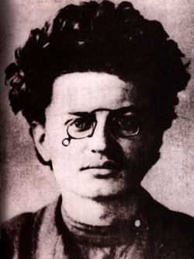
Area of study one
KEY POINTS
Trotsky, like Lenin, was absent for much of the lead up to the February revolution
However, his role in organising and leading the Soviets in 1905 is significant
His reconciliation with Lenin in 1917 led him to the Bolsheviks
His leadership was crucial to the success of the October Revolution

Slide 3
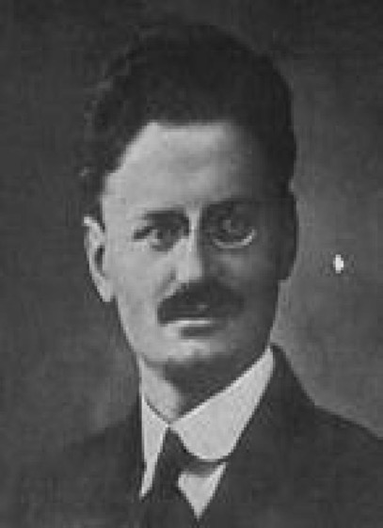
Area of study one
In the lead up to 1905, Trotsky had been exiled for his socialist lectures and writing in Iskra
At the 1903 Social Democrat Congress he supported the Mensheviks when they split from the Bolsheviks
Despite this, he attempted, on many occasions, to reunite the ‘warring factions’
On his return, he helped establish the Petrograd Soviet in 1905. At age 26, he is elected chairman of the Soviet.

Slide 4
Area of study one
The Soviet was formed to discuss greivances of workers, created by Sergei Witte’s industrial reforms.
It was this Soviet that called for a ‘National General Strike’ in 1905
It could then easily be argued, that Trotsky played an influential role in 1905 and thus, an important one in developing a revolutionary situation
He was exiled for his involvement in the protest.

Slide 5
Area of study one
In response to the October Manifesto he stated:
“we have been given a constitution, but absolutism remains. Everything is given and nothing is given”

Slide 6
Area of study one
After 1905, he stated that:
“although with a few broken ribs, Tsarism came out of the experience of 1905 alive and strong enough”

Slide 7
Area of study one
After 1905, he was sent into exile. He lectured on Socialism around Europe between 1907 and 1917.
He was absent for the beginning of WW1, the formation and destruction of the Dumas and the many strikes leading up to February 1917.
February 1917: The Provisional Government asks the British Govt. to detain Trotsky to prevent his return.

Slide 8
Area of study one
Trotsky was actually in New York when Tsar Nicholas abdicated.
He clearly represented a genuine threat to the stability of the February Revolution and Provisional Government.
This can easily be linked to the growin power of the Petrograd Soviet.
With Trotsky returning, the Soviet would have a popular leader.

Slide 9
Area of study one
“Trotsky moved like a bright comet across the political sky. He first came to global attention in 1917. By all accounts he was the finest orator of the Russian Revolution.”
Robert Service

Slide 10
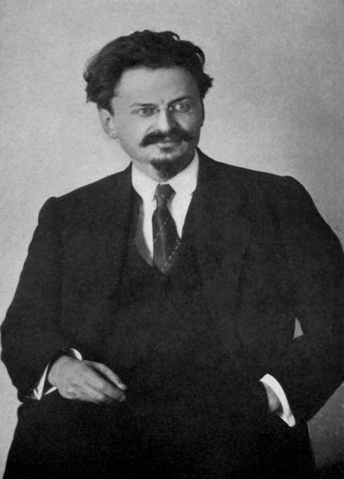
Area of study one
May 1917. Trotsky returns to Petrograd, paraded and carried on the shoulders of workers.
In line with Lenin’s ideology, he advocated for an advancement beyond the Bourgeoise stage of revolution, towards the ‘proletarian stage’
Significantly, he breaks from the Mensheviks in July for two reasons:
They supported Russia and Kerensky’s decision to continue WW1
They felt the revolution had gone far enough

Slide 11
Area of study one
Trotsky saw the July Days of 1917 as a failure of organisation.
Trotsky wrote to the Provisional Government to pledge his support for the July rebels.
He is imprisoned by Kerensky. He is soon released.
Once free, he raises his profile in the Petrograd Soviet and in the Bolshevik Party.
In July / August, he had a much larger public profile than Lenin (who was in hiding)

Slide 12
Area of study one
In August 1917 Trotsky observed that:
“the factory committees… are in an overwhelming majority made up of Bolsheviks. In the Petrograd trades unions everyday practical work… lies wholly with the Bolsheviks. In the workers’ section of the Petrograd Soviet, the Bolsheviks constitute an overwhelming majority.”

Slide 13
Area of study one
Trotsky’s superior oratory skills saw him rise as President of the Petrograd Soveity in September 1917.
By that stage, it was politically dominated by the Bolshevik party.
The slogan ‘All power to the Soviets’ now had a legitmate leader.

Slide 14
Area of study one
In October, Trotsky sided with Lenin’s ideology.
Trotsky gave Lenin his full support
“I told Lenin that nothing separated me from his April Thesis and from the course that the party had taken since his arrival”

Slide 15
Area of study one
October 1917: The Mensheviks suggested that the Petrograd Soviet form the Military Revolutionary Committee (MRC), initially to defend Petrograd from German attack.
The Bolsheviks cunningly suggest that the MRC should also defend Petrograd from counter-revolutionary attack
Trotsky advises Petrograd Soviet to overthrow Prov. Govt. As main member of MRC, he organises Red Guards – armed by the Kornilov affair.

Slide 16
Area of study one
Trotsky won over the support of the Petrograd Soviet.
Trotsky asked the Petrograd Garrison to pledge its support (21 October).
By October 1917, only about 5% of the Petrograd Garrison of 160,000 was willing to support the Prov. Govt.
Trotsky organised and led the October 24 takeover of Petrograd.

Slide 17
Area of study one
Views on Trotsky’s contribution:
Lenin was the strategist, Trotsky was the tactician.
Lenin was the architect of the October Revolution, Trotsky was the master builder

Slide 18
Area of study one
Views on Trotsky’s contribution:
Trotsky:
“Had I not been present in 1917 in St. Petersburg, the October Revolution would still have happened – on the condition that Lenin was present and in command. If neither Lenin nor I had been present, in Petersburg, there would have been no October Revolution: the leadership of the Bolshevik Party would have prevented it from occurring.”

Slide 19
Area of study one
Views on Trotsky’s contribution:
Spunde (fellow Bolshevik)
“Trotsky displayed his best qualities in 1917. He was the idol of the mass meetings in Petrograd. Determination and boldness showed in everything he did….. Trotsky was one of the best speakers of the revolution. He spoke everywhere with amazing brilliance and had the ability to popularise even difficult ideas with great skill.”

Slide 20
Area of study one
PRACTICE QUESTIONS:
What was Trotsky's role in the Revolution of 1905?'
What was Trotsky's contribution to the revolution of October 1917?

Slide 21
Area of study Two
KEY POINTS
Trotsky played a key role in the Treaty of Brest Litovsk.
He was an important member of the Communist Party Politburo
Trotsky’s organisation of the Red Army and political and military leadership during the Civil War was critical.
Despite his skill as a public speaker and broad popularity, he became unpopular with other Bolsheviks for his arrogance.

Slide 22
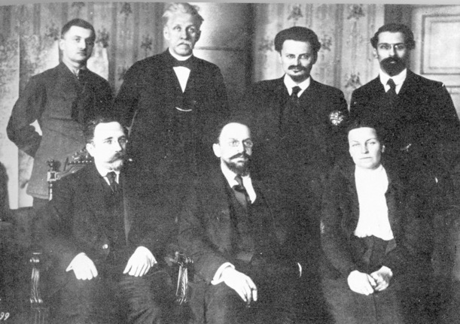
Area of study TWO
Trotsky deliberately delayed and frustrated the German delegates.
He believed that mutiny and revolution among the German army was inevitable. Winning over significant opposition from other Bolsheviks
It never happened.
The stalling tactic led to the German’s attacking Petrograd and the Bolsheviks moving their capital to Moscow

Slide 23
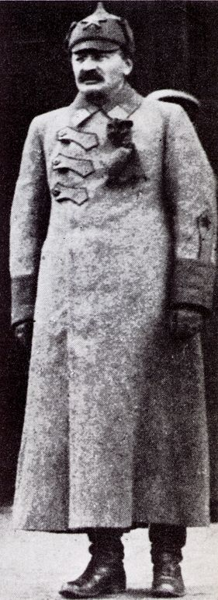
Area of study TWO
Trotsky became Commissar of War in 1918.
More than any other leader, Trotsky consolidated the revolution during the emergency of 1918-1920.
He was instrumental in organising the Red Army

Slide 24
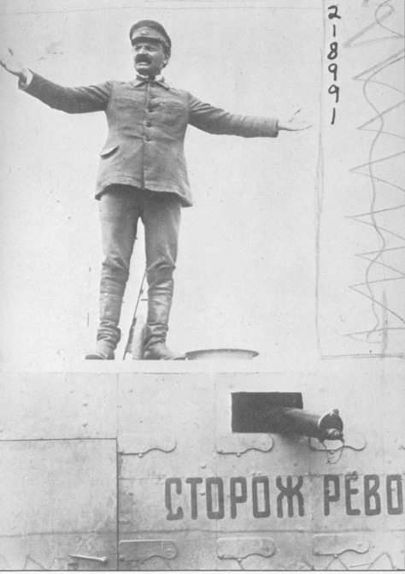
Area of study TWO
Trotsky combined charismatic persuasiveness with brilliant logistic skills.
When his Red soldiers were frightened by British tanks, he had the Putilov Steekworks knock up some Red ‘tanks’ to reassure his troops.
Trotsky now displayed extraordinary organisational skills in logistics: providing weapons, ammunition, food and medical supplies to a large army fighting on multiple fronts.

Slide 25
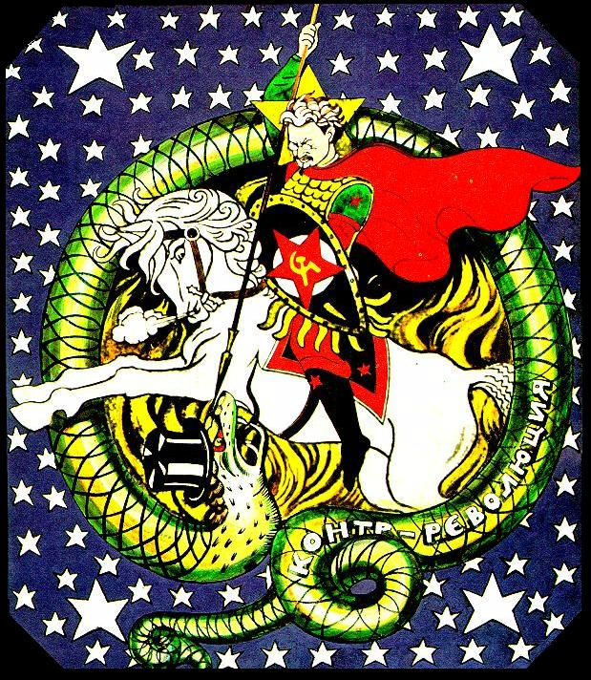
Area of study TWO
Soviet propaganda potrayed him slaying the ‘White Dragon’.
Trotsky also made new use of an existing technology, building an armoured train, taking control of the railways system, and using it to criss-cross Russia from battle front to battle front.
Red army troops thought he was almost superhuman.

Slide 26
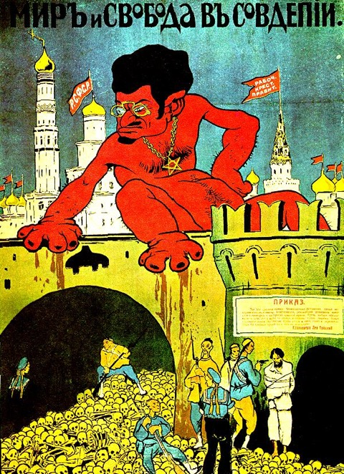
Area of study TWO
White propaganda
The White Armies made much of Trotsky’s Jewish background
They assumed this would paint him as an ‘outsider’ to Russian peasants.

Slide 27
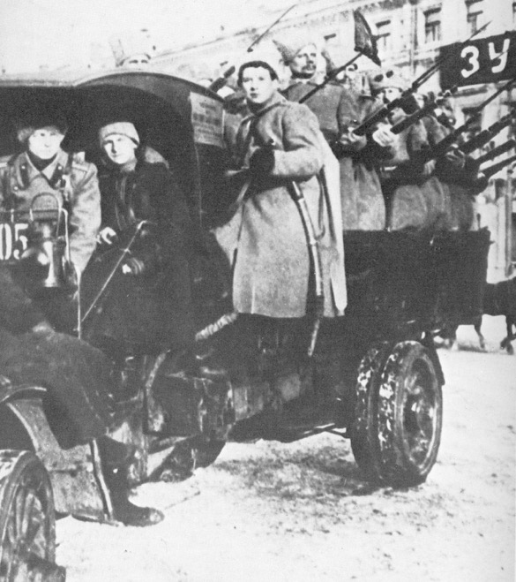
Area of study TWO
Trotsky was responsible for the transfer of the 1917 Red Guard into the larger and more diciplined Red Army.
Historian Michael Lynch argues that:
Trotsky did understand the issues of discipline and deference that had been raised as early as Soviet Order number 1 (1917), and did initially try to create an army without ranks and badges, but quickly discovered that this would not work.

Slide 28
Area of study TWO
Trotsky was known for his ruthless attitude towards victory.
After 200 hundred Red Army deserters were captured, he ordered all of them to be executed
Historian Deutcher:
“Trotsky had not shrunk from using Terror in the Civil War…. He was a little fond of it as a surgeon is fond of bloodshed”

Slide 29
Area of study TWO
On the execution of the Romanovs Trotsky said:
“The execution of the Tsar and his family was needed not only to frighten, horrify and instill a sense of hopelessness in the enemy, but also to shake up our own ranks, to show that there was no retreating, that ahead lay total victory or total doom”.

Slide 30
Area of study TWO
He strengthened the Red Army by conscripting 50,000 former Tsarist officers to lead the Red Army.
Each one was shadowed by a politcal commissar
Many of their families had been held hostage by the Cheka.
By 1920, the Red Army had grown to 5 million men

Slide 31
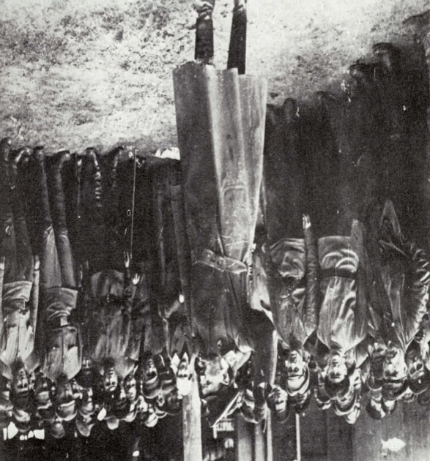
Area of study TWO
Trotsky played a critical role in implementing War Communism
At the start of 1920, he introduced the idea of ‘the militarisation of labour’ meaning that, as Commissar for War, he was going to apply military style discipline to industrial production
A policy that was hated by the 1921 as noted in the greivances of The Kronstadt Sailors and Alexandra Kollontai

Slide 32
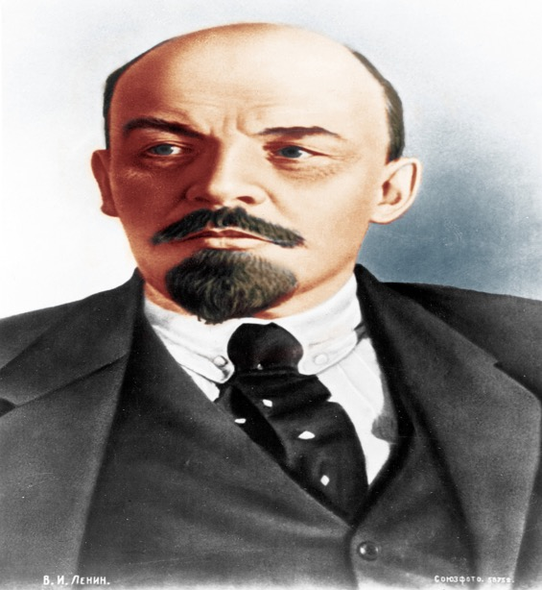
Area of study TWO
Prior to his death, Lenin admitted:
… Trotsky had “exceptional abilities”, calling him the most able man in the committee, but feared “his over-reaching self-confidence” and his tendency to concentrate on administrative detail.

Slide 33
Area of study TWO
His arrogance led to his defeat in the leadership struggle with Stalin
Ward:
“Trotsky and Bukharin might win the argument, but Stalin invariably won the vote”.
Deutscher:
“It seemed to Trotsky almost a bad joke that Stalin, the willful and sly but shabby and inarticulate man in the background should be his rival”.

